Slide 1
Food Store Location Analysis Albuquerque New Mexico, 2010 Prepared for: Geography 591(Problems) and 580L(Quant. Methods) Fall Semester 2015 – Presented 11/30/2015
Larry Spear M.A., GISP
Sr. Research Scientist (Ret.)
Division of Government Research
University of New Mexico
http://www.unm.edu/~lspear
R script – http://www.unm.edu/~lspear/abq_gravmod_v2.R
QGIS R script – http://www.unm.edu/~lspear/GravMod_Retail_V2.txt
Final Project (OLS-Global & GWR Local) R Version – Update 11/21/15

Slide 2
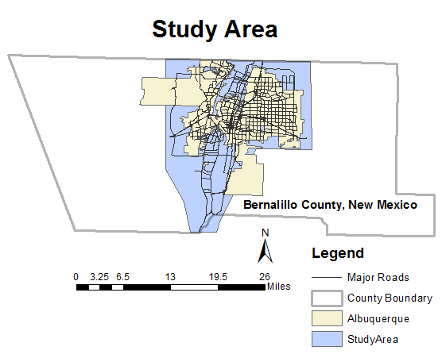

Slide 3
Background – Original Research
Follow-up to thesis research 1979 to 1982 (completed)
Also Applied Geography Conference, 1985 (N. Texas)
Previous work using 1970 and 1980 data
Used state-of-art technology at the time
Pen and Ink and Zip-a-Tone (decal) cartography
SAS (Statistical Analysis System)
ESRI’s Automap II (first product) FORTRAN based
IBM Mainframe computer at UNM
Combination of SAS(database and stat.) and Automap II (mapping) = Very Early GIS capabilities!
SAS and ArcGIS (SAS Bridge) another Up-To-Date way to accomplish, but not the focus of this R presentation.

Slide 4
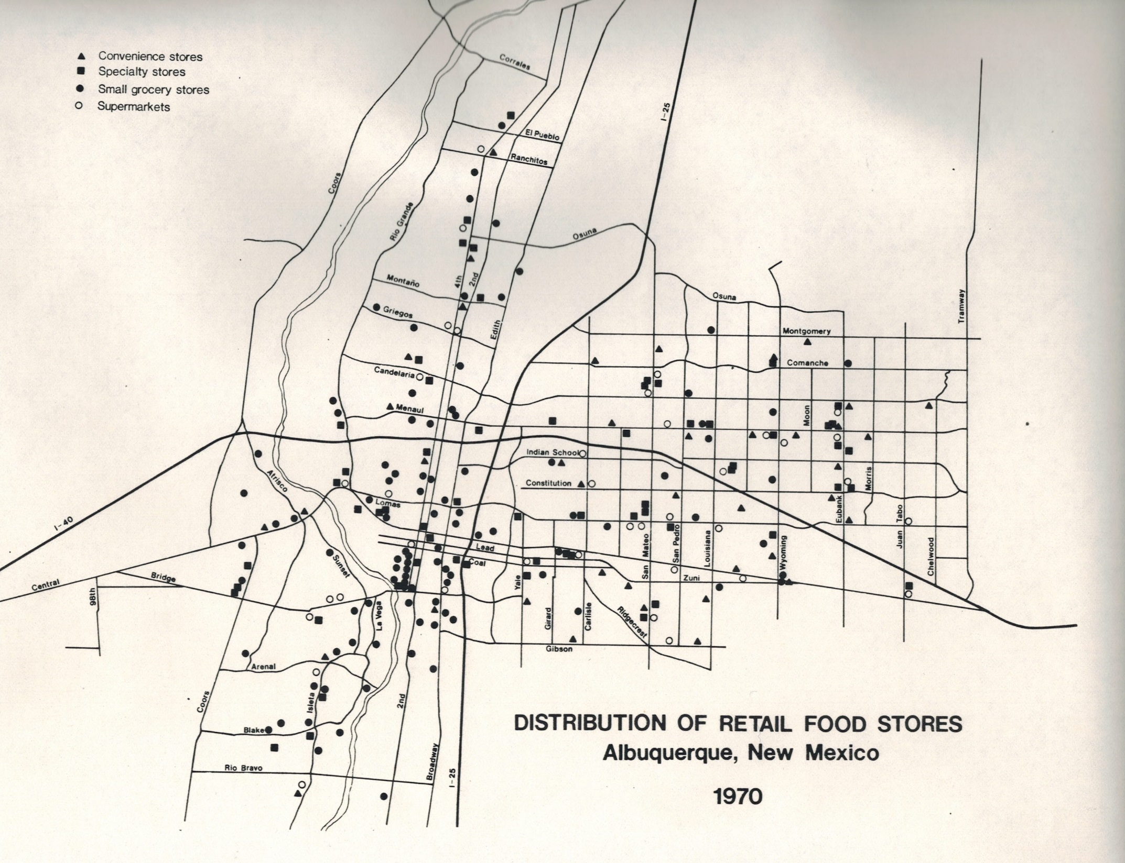
From MA Thesis, 1982

Slide 5
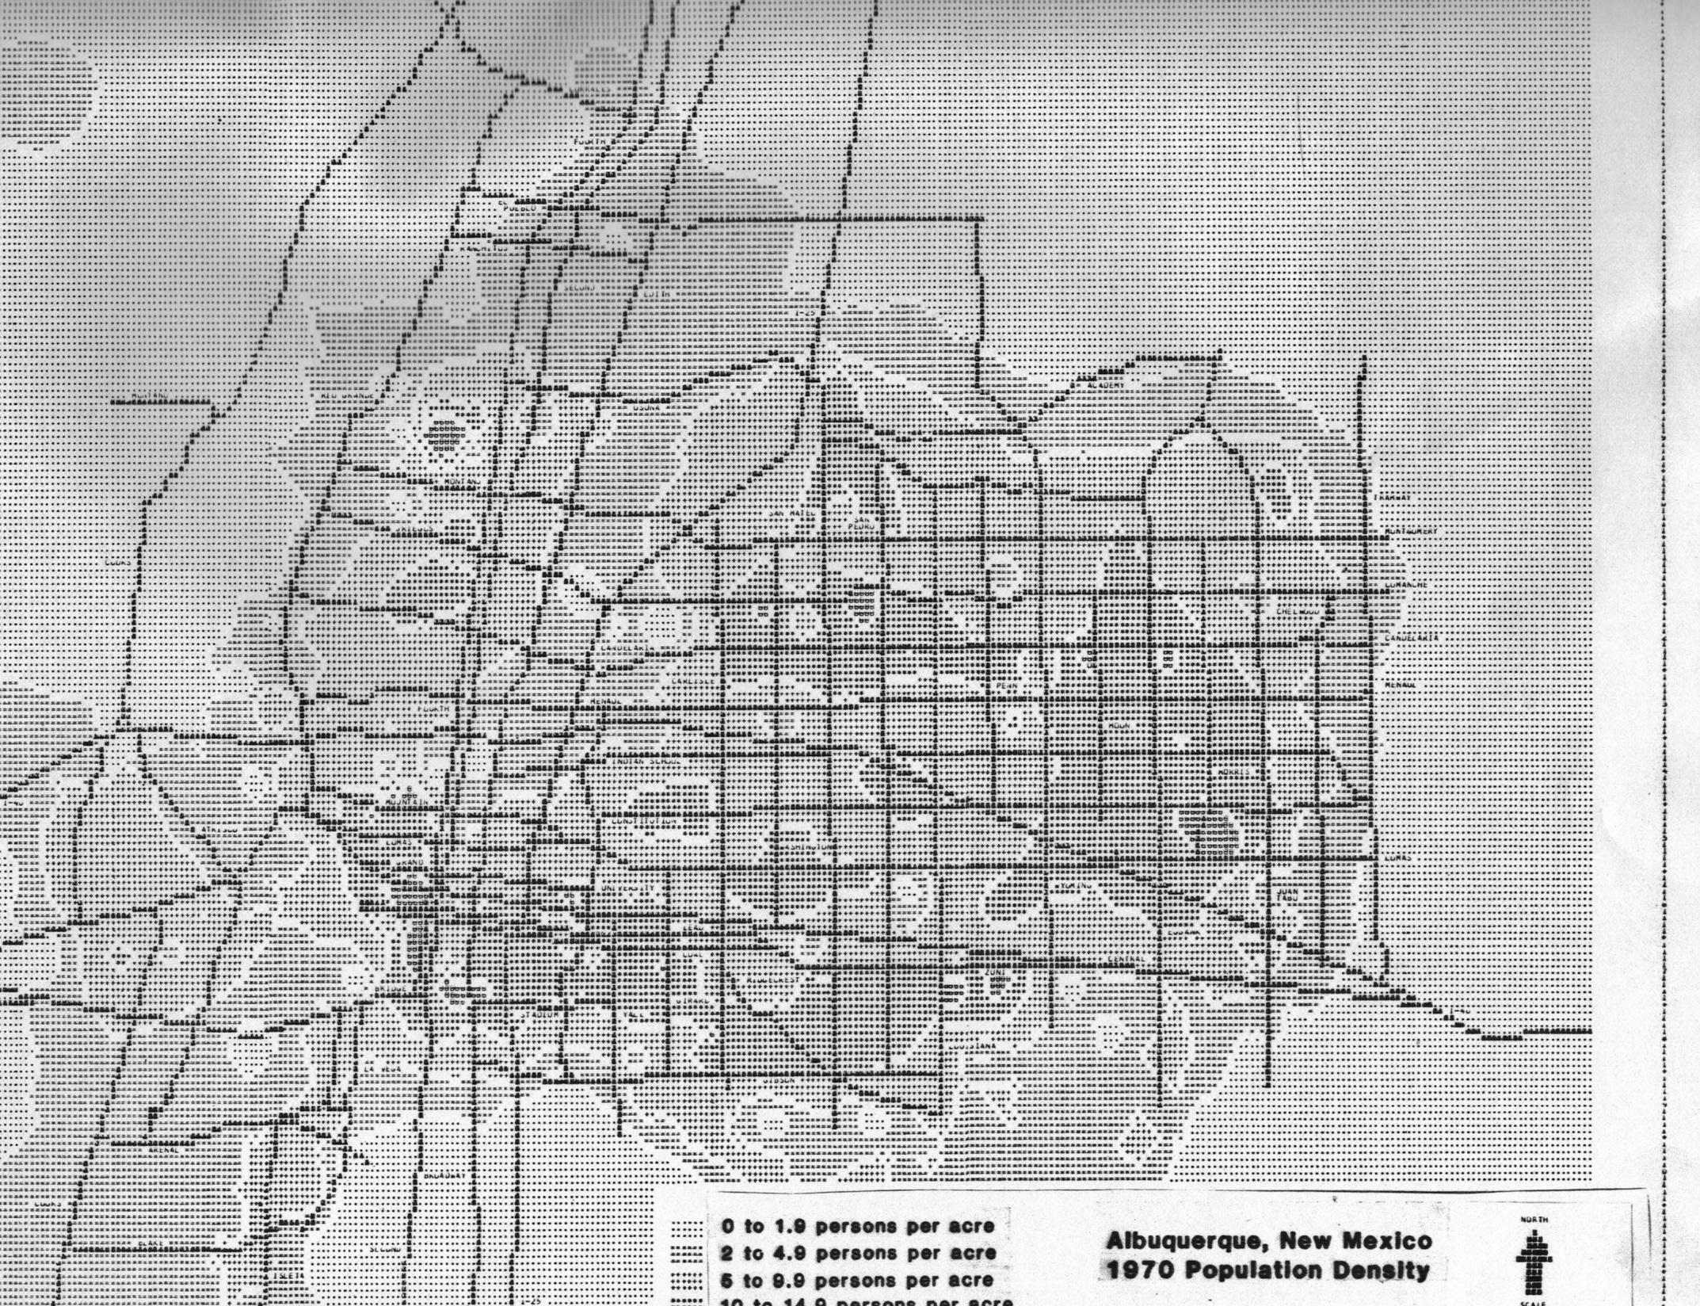
From MA Thesis, 1982

Slide 6
Background – Recent Research
Updates with recent 2010 data and newer GIS and statistical facilities (using OLS and GWR methods)
Recently - Geography 586L (Applications of GIS), Spring 2014 – Combined ArcGIS Desktop, Python (ModelBuilder), SPSS, and Minitab (see earlier PowerPoint on my web page: http://ww.unm.edu/~lspear/Food_Store_Location_v9.pptx)
Now - Geography 591 (Problems) & Geography 580L (Quantitative Methods), Fall 2015 – Combined R and QGIS

Slide 7
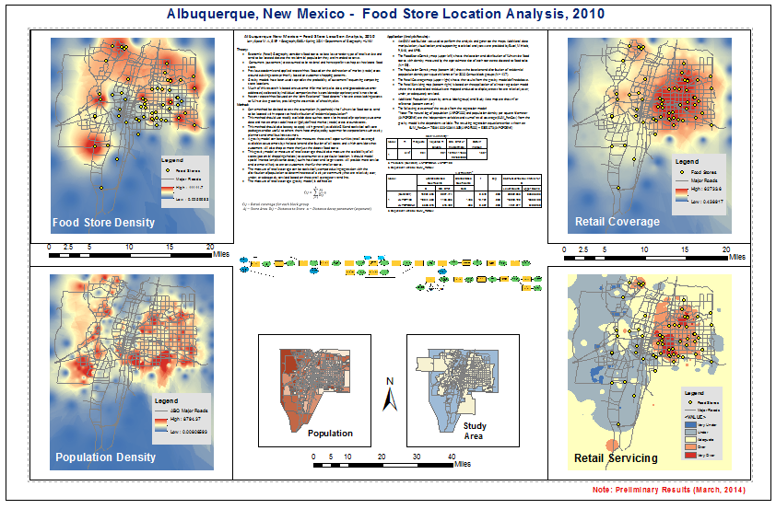
From Applications of GIS, Spring 2014 (ArcGIS ModelBuilder)

Slide 8
Research Project Components
A well defined research project should address
- Theory (previous research and practice)
- Method (established and proposed statistical and spatial techniques)
- Application/Results (maps, tables, charts, and future research)
This presentation will discuss these issues
Also focus on R (problems and solutions?)

Slide 9
Theory
Economic Geography and Retail Geography (sub-field)
-Food stores are lower-order retail service
-Tend to locate close to residential customer population they are intended to serve
Most previous research focused on customer shopping patterns
-Delineation of trade or market areas
-Based on rational customers (consumers) who always shop at closest store - Who does this??
Also proprietary sales (geocoded customer location) data collected by individual companies (*Not Shared)
Most shoppers will travel a reasonable (threshold) distance and frequent several alternative stores within this distance.

Slide 10
Method
Can a method be employed (developed) to:
-Test assumption (hypothesis) that full-service food stores tend to locate with respect to residential population – Research question?
Needs to use readily available (non-proprietary) store and population (potential customer) data
Should be easy to apply with generally available GIS and statistical software
Should be useful to others (not just supermarket corporations) like city planners and small business owners
** Several ways to develop (ArcGIS-Python, R or QGIS-Python, R). Shapefiles <-> SPDF, DF, Vectors/Lists ??

Slide 11
Method – Gravity Model
Gravity model developed to measure overall opportunity (retail coverage) available to customers provided by location and size of all stores
Potential shopping choices without any assumption of customers just shopping at the closest store
Spatial Interaction – closer larger stores are more attractive than smaller distant stores.
$$Cij= \sum_{j=1}^{k}{\frac{Aj}{Dij}a}$$
$Cij−Retail coverage for each block group$
$Aj−Store Area$ $Dij−Distance to Store a−Distance decay parameter (exponent)$

Slide 12
Spatial Interaction and Distance Decay

Slide 13
Application – (Data Sources)
ESRI Shapefiles used during previous (Spring 2014) ArcGIS (ModelBuilder) project.
Layer 1 – Food Store Density, approximate size of store (n=59, ArcGIS World Imagery, Geocoding)
Layer 2 – Population Density per square kilometer by census block group 2010 (n=417)
Layer 3 – Retail Coverage from Gravity Model
Layer 4 – Retail Servicing from regression (OLS – Global and GWR - Local), maps of standardized residuals
Note: Full-Service stores only & food sales floor area est.

Slide 14
Input Data – Shapefiles to SpatialDataFrames

Slide 15
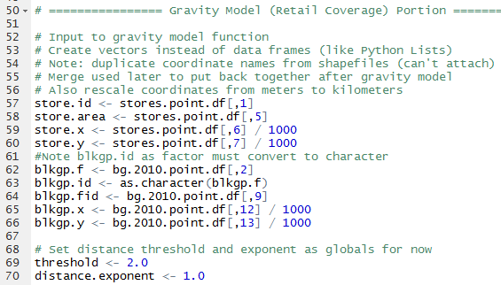
Gravity Model Development Note: Vector input could be dataframe or SpatialPointDataFrame??

Slide 16
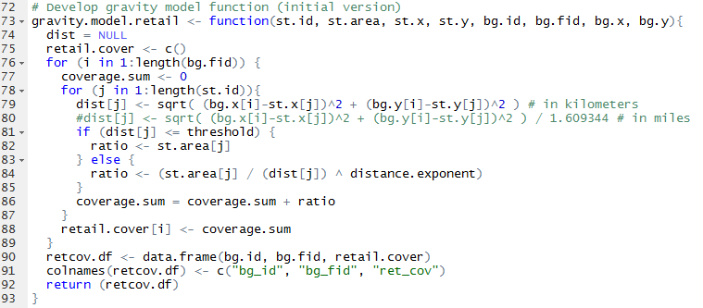
Gravity Model Development *Note: Nested for loops (i - Block Groups, j – Food Store)

Slide 17
Method – Ordinary Least Squares Regression (OLS – Global, R lm)
Measure of retail coverage (gravity model) statistically compared with population
Population from 2010 Census block groups (population density)
Regression determines the expected (predicted or “average”) retail coverage value(s) given observed population (density) values:
$$RetCov= β0+ β1PopDen+ εi$$
Note: determine relatively over (+), under (-), or adequate (≈0) serviced areas (map of standard residuals, observed - expected)
*Not strictly an explanatory model – an “average”

Slide 18
Review Data – Dependent Variable Note: close to normal (skewness 0.1163634) Linear regression does not require normal data
> skewness(ret_cov) [1] 0.1163634

Slide 19
Review Data – Independent Variable Note: Transform unnecessary (skewness 1.445922) Most demographic and geographic data skewed
* If data transformed data should explain why necessary

Slide 20
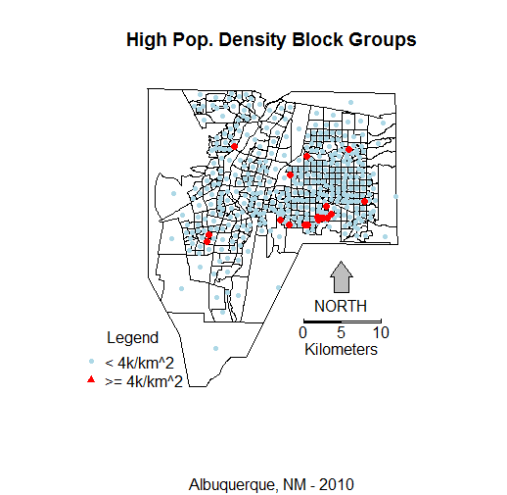
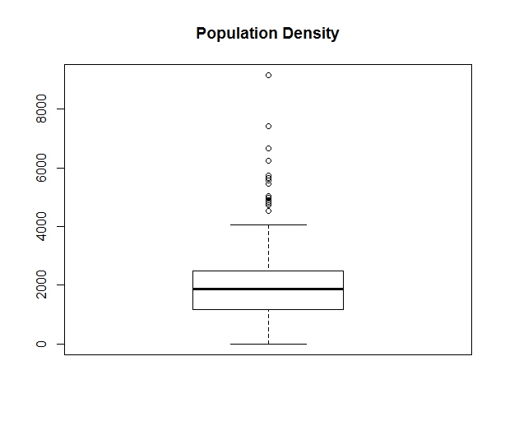
Review Data – Outliers * Apartments and trailer parks

Slide 21
Review Data - Correlation
ret_cov POP100 LNPOP100 POPDENK LNPOPDENK
ret_cov 1.0000000 -0.40269283 -0.38244515 0.23093568 0.36094548
POP100 -0.4026928 1.00000000 0.95681875 0.07706396 0.04485801
LNPOP100 -0.3824451 0.95681875 1.00000000 0.09761179 0.05936509
POPDENK 0.2309357 0.07706396 0.09761179 1.00000000 0.80945320
LNPOPDENK 0.3609455 0.04485801 0.05936509 0.80945320 1.00000000

Slide 22
Results – Ordinary Least Squares * Note outliers (high value POPDENK block groups)

Slide 23
Results – Ordinary Least Squares *Note Normal QQ variation (low & high values) Leverage effects of high values – Heteroscedasticity of residual errors

Slide 24
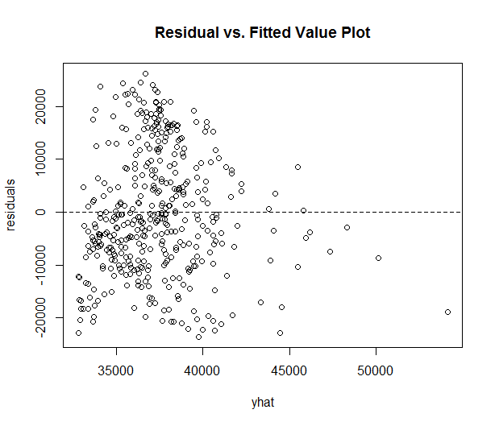
Results – Ordinary Least Squares *Note – Relatively Normal Residuals - – Heteroscedasticity of residual errors
*Heteroscedasticity (unequal error variance) violates OLS assumption
A common problem with geographic data

Slide 25
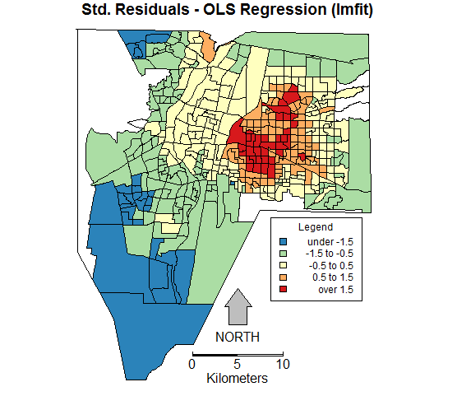
Results – Ordinary Least Squares Clustered (spatial autocorrelation*) expected – violates OLS assumption
* Common
occurrence
with
geographic
data
Moran’s I
0.898087
P < 2.2e-16

Slide 26
Method – Geographically Weighted Regression (GWR – Local, R gwfit)
Given that data and OLS results (not independent – spatial autocorrelation) GWR may be more useful
The OLS (global) results do not adequately represent the variation of local data
GWR constructs separate regression equation for every feature (fit point) based on nearby features within a weighted window( band width)
$RetCov= β0\left(x,y\right)+ β1\left(x,y\right)PopDen$ $+ εi$
Note: determine relatively over (+), under (-), or adequate (≈0) serviced areas (map of standard residuals, observed - expected)
Also: GWSS (Geographically Weighted Summary Statistics) – Maps of local correlation, etc.

Slide 27
Results – Geographically Weighted Correlation *Note: Local Variation

Slide 28
Results – Geographically Weighted Regression *Note: R-square value 0.902, Adj. R-square value 0.886

Slide 29
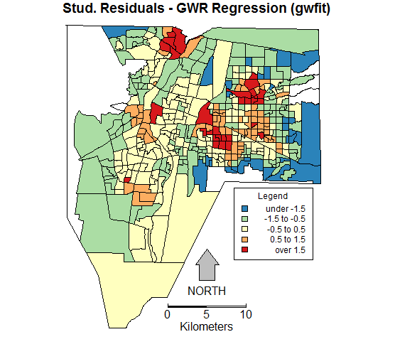
Results – Geographically Weighted Regression *Note: Better delineation of retail servicing (local variation)

Slide 30
Summary – GWR Proves Useful
GWR looks to provided better resolution to identify relative over, adequate, or under serviced areas.
GWR takes into account the local variation between the relationship (correlation) of retail coverage to population density.
More effort (research) necessary to better calibrate the GWR model (band width and kernel type).
An ArcGIS (ArcPy) script (not ModelBuilder) and a QGIS (PyQGIS) script using Python for the gravity model can be developed in the future, perhaps more efficient than R. Also PySAL (Python Spatial Analysis Library).

Slide 31
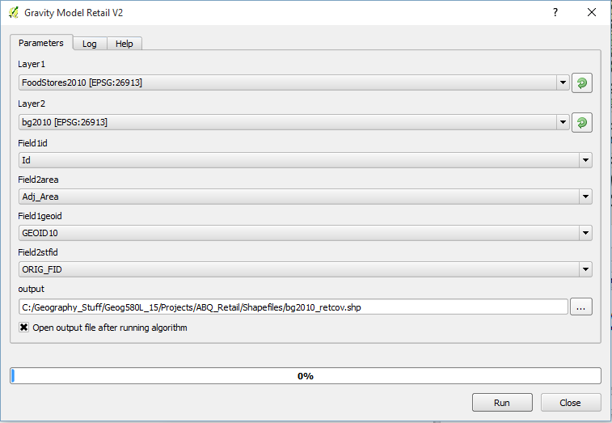
Additional – QGIS and R QGIS R Processing Script – Initial Version – Retail Coverage Only!

Slide 32
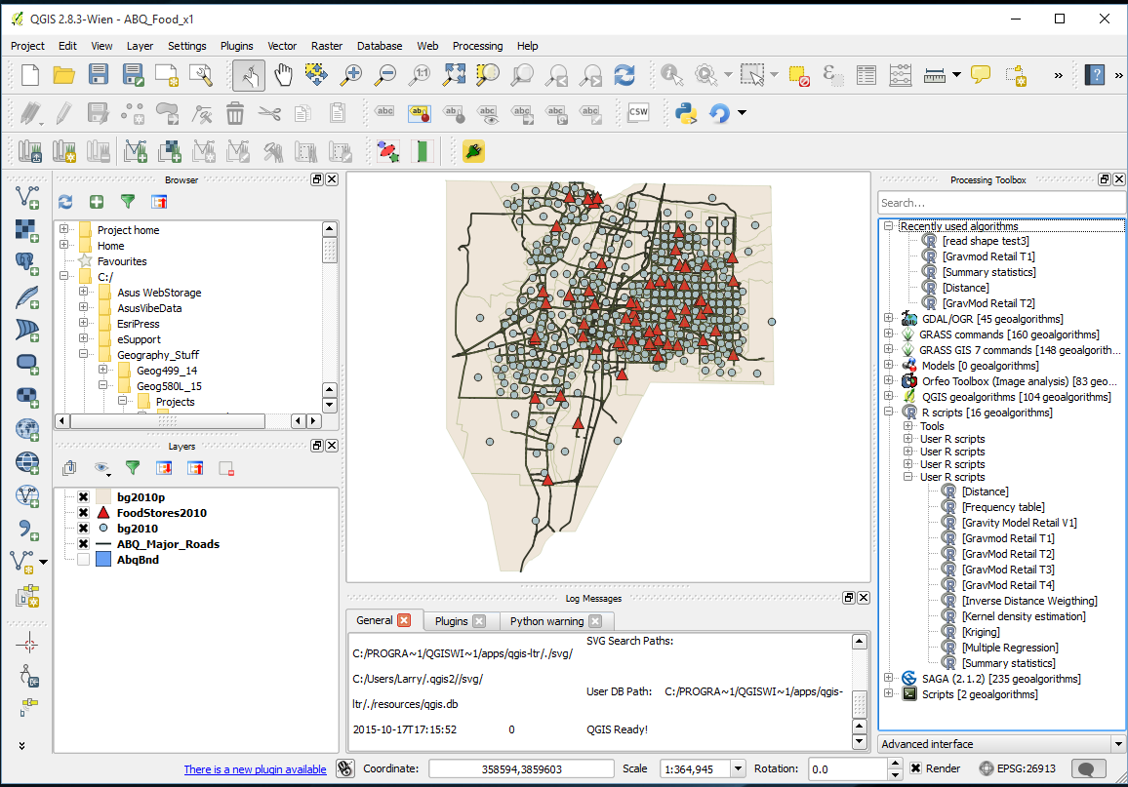
QGIS – Albuquerque Food Store Gravity Model Project - Start

Slide 33
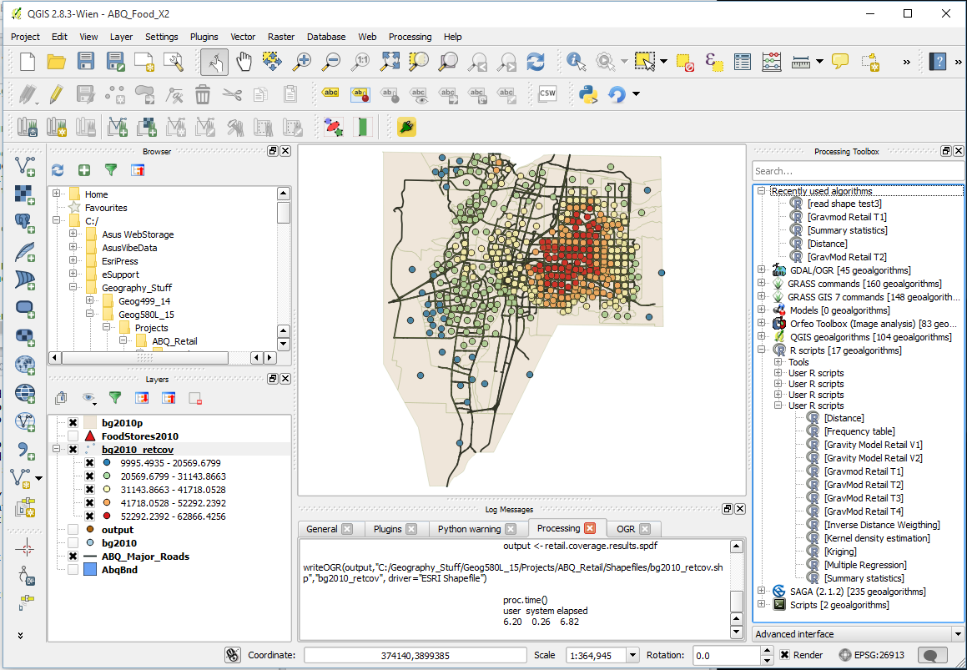
QGIS - Albuquerque Food Store Gravity Model Project – Initial Result

Slide 34
Conclusion – More than one way! *Note: ArcGIS and SAS have University Site Licenses ArcGIS Student Edition (free) & SAS Studio U. Edition (free)
R and QGIS – data frames and spatial data frames useful, R statistics (graphics) and spatial statistics exceptional, poor R mapping capabilities (good in QGIS), harder to learn (Note: Python available) – Free!
ArcGIS and Python – Well developed shapefiles and geodatabases, improving statistics and spatial statistics, great maps, easier to learn (New R Bridge)– Expensive!
ArcGIS and SAS – Well developed data sets and data manipulation, exceptional statistics and improving spatial statistics, great maps, not difficult to learn (Note: SAS Bridge available) – Expensive!

